Slide 1
SQL Containers in the Cloud! An intro to running Docker in Azure

Slide 2

About Me
Andrew Pruski
@dbafromthecold
dbafromthecold@gmail.com
www.dbafromthecold.com
SQL Server DBA & Data Platform MVP
Originally from Wales, now living in Dublin

Slide 3
Session Aim
To give an overview of the different options available to run SQL Server Docker containers in Azure

Slide 4
Agenda
Azure Container Registry
Azure Container Instances
Azure Container Services (ACS & AKS)
Other options

Slide 5
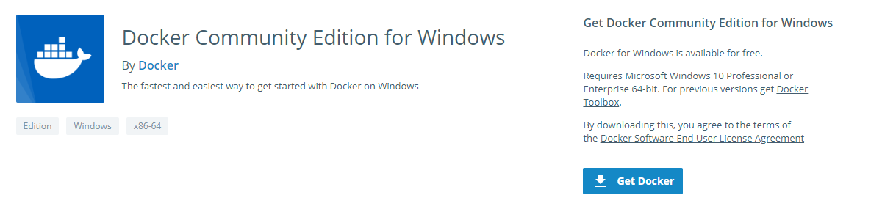
Tools – Docker for Windows
https://store.docker.com/editions/community/docker-ce-desktop-windows

Slide 6
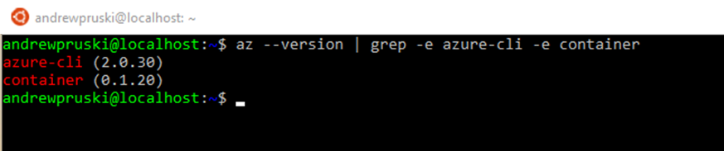
Tools – Azure CLI
Command line tool for managing Azure resources
Available on Windows, Mac, or Linux (incl. WSL)
https://docs.microsoft.com/en-us/cli/azure/install-azure-cli?view=azure-cli-latest

Slide 7
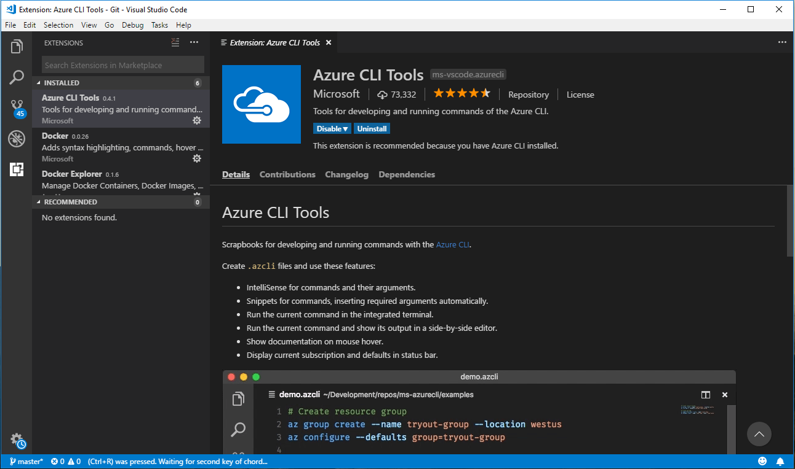
Tools – Visual Studio Code

Slide 8
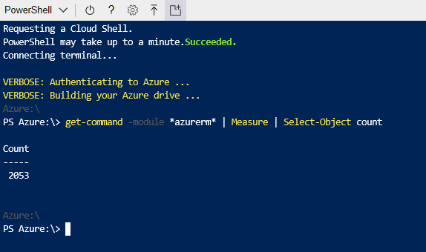
Tools – Powershell
AzureRM module
Install locally or in CloudShell
Huge amount of commands available

Slide 9
Azure Container Registry

Slide 10
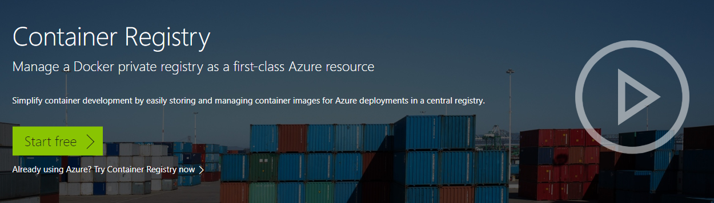
Azure Container Registry
https://azure.microsoft.com/en-us/services/container-registry/

Slide 11
Azure Container Registry - Terminology
Registry
Service that stores container images
Repository
Groups of container images – Same name, identified by tags

Slide 12
Azure Container Registry - Features
Encryption
All images encrypted at rest
Geo-redundant storage
Replication of images
Geo-replication
Guards against total regional failure
ACR Build
Container image build service

Slide 13
Azure Container Registry - SKUs
Type | Basic | Standard | Premium
Storage (GB) | 10 | 100 | 500
ReadOps/min | 1000 | 3000 | 10000
WriteOps/min | 100 | 500 | 2000
Download MBps | 30 | 60 | 100
Upload MBps | 10 | 20 | 50
Webhooks | 2 | 10 | 100
Geo-replication | No | No | Yes
https://docs.microsoft.com/en-us/azure/container-registry/container-registry-skus

Slide 14
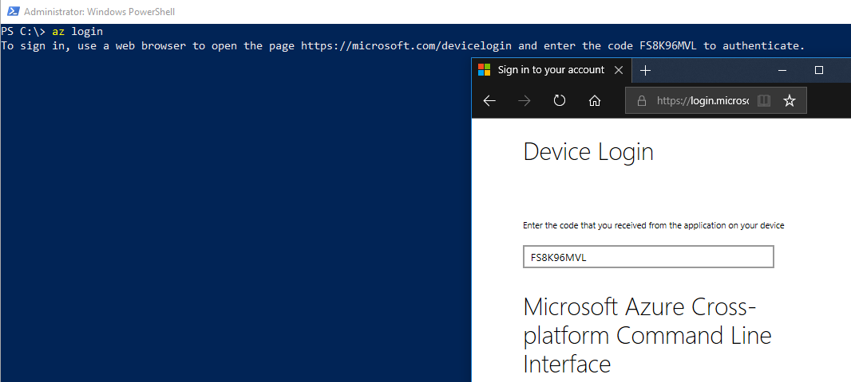
ACR - Login
az login

Slide 15
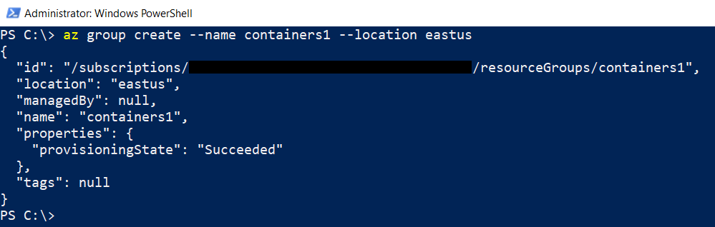
ACR – Create Resource Group
az group create --name containers1 --location eastus

Slide 16
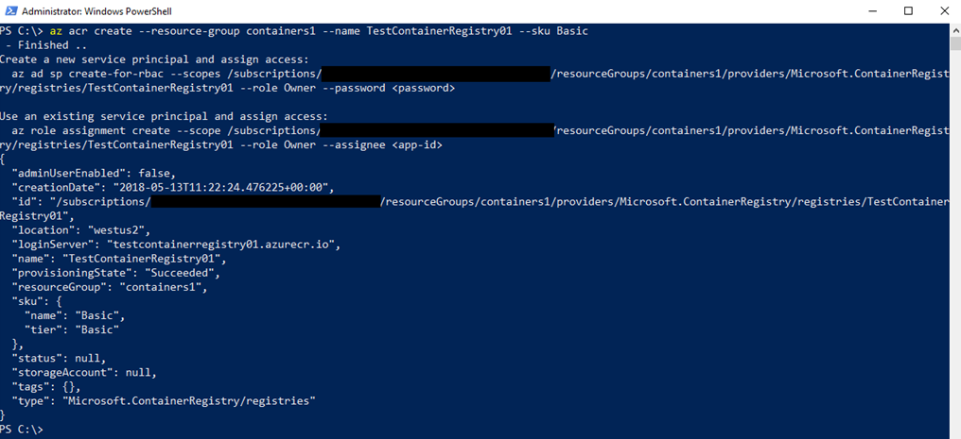
ACR – Create Container Registry
az acr create --resource-group containers1 `
--name TestContainerRegistry01 --sku Basic

Slide 17
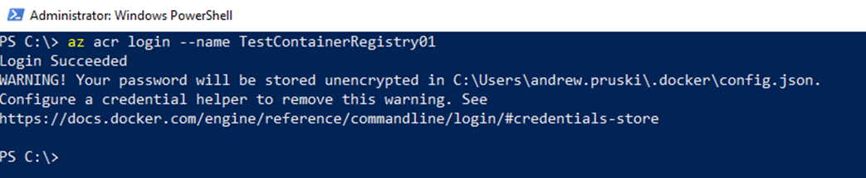
ACR – Log into Registry
az acr login --name TestContainerRegistry01

Slide 18
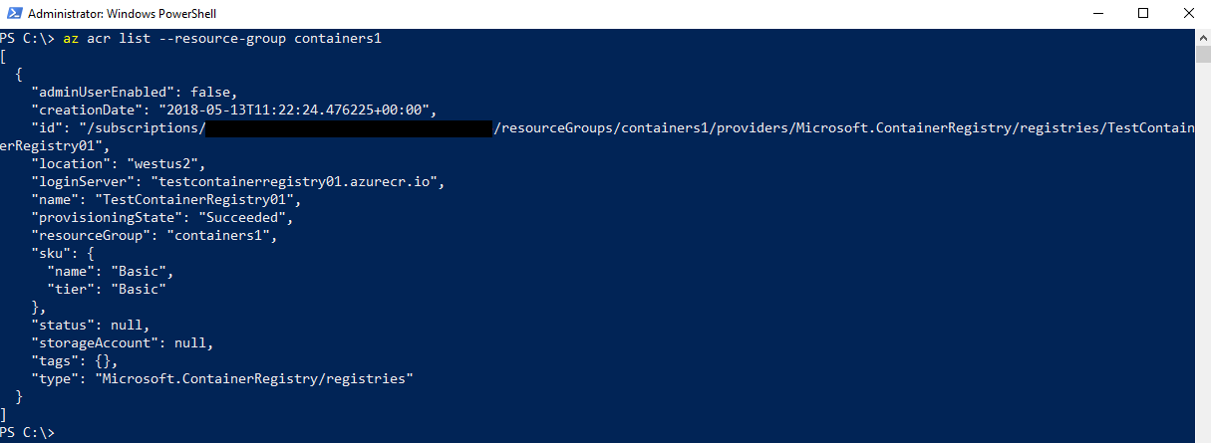
ACR – Get Registry Details
az acr list --resource-group containers1

Slide 19
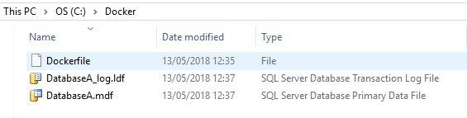
ACR – Dockerfile
FROM microsoft/mssql-server-linux:latest
CMD mkdir /var/opt/sqlserver
COPY DatabaseA.mdf /var/opt/sqlserver
COPY DatabaseA_log.ldf /var/opt/sqlserver
ENV MSSQL_BACKUP_DIR="/var/opt/sqlserver"
ENV MSSQL_DATA_DIR="/var/opt/sqlserver"
ENV MSSQL_LOG_DIR="/var/opt/sqlserver"
HEALTHCHECK --interval=10s \
CMD /opt/mssql/bin/sqlservr & \
/opt/mssql-tools/bin/sqlcmd -S . -U sa -P $SA_PASSWORD \
-Q "CREATE DATABASE [DatabaseA] ON (FILENAME = '/var/opt/sqlserver/DatabaseA.mdf’),
(FILENAME = '/var/opt/sqlserver/DatabaseA_log.ldf') FOR ATTACH"

Slide 20
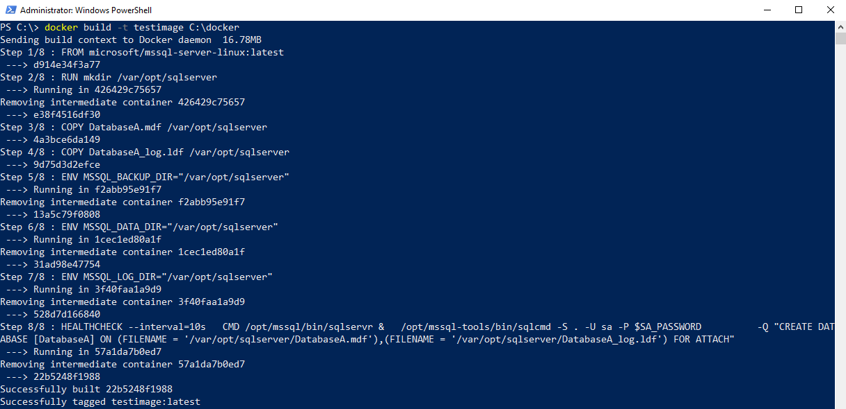
ACR – Build image
docker build -t testimage C:\docker

Slide 21
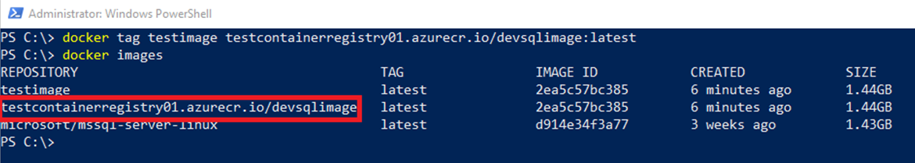
ACR – Tag Custom Image
docker tag testimage ` testcontainerregistry01.azurecr.io/devsqlimage:latest

Slide 22
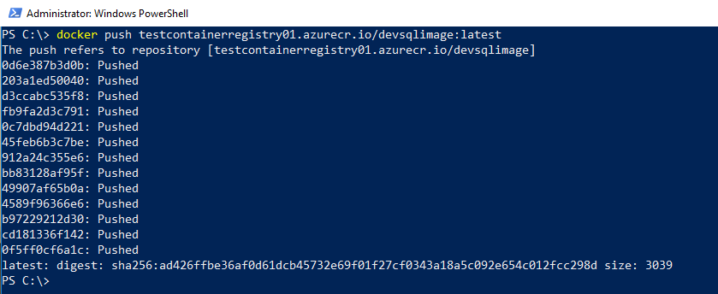
ACR – Push Image
docker push testcontainerregistry01.azurecr.io/devsqlimage:latest

Slide 23
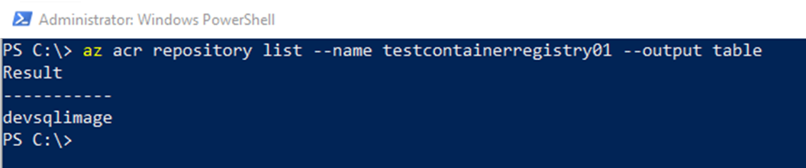
ACR – List Images
az acr repository list --name testcontainerregistry01 --output table

Slide 24
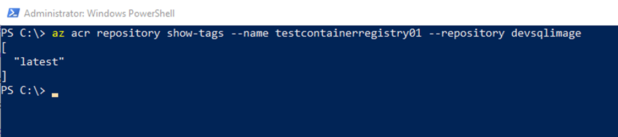
ACR – Show Tags
az acr repository show-tags `
--name testcontainerregistry01 `
--repository devsqlimage

Slide 25
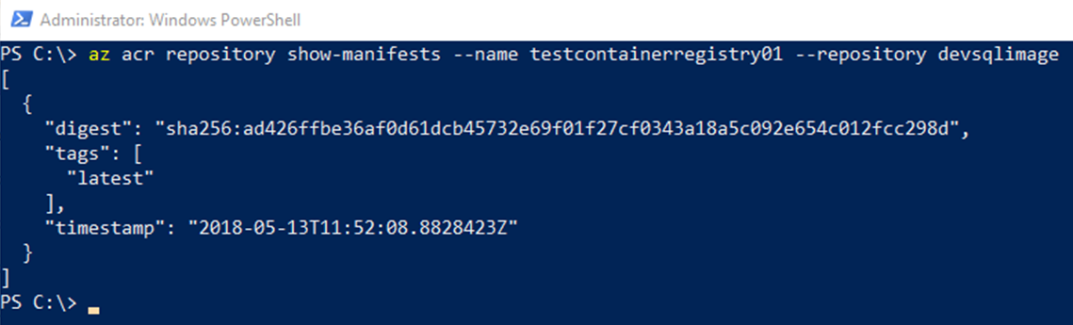
ACR – Show Manifest
az acr repository show-manifests `
--name testcontainerregistry01 `
--repository devsqlimage

Slide 26
Demo

Slide 27
Azure Container Instances

Slide 28
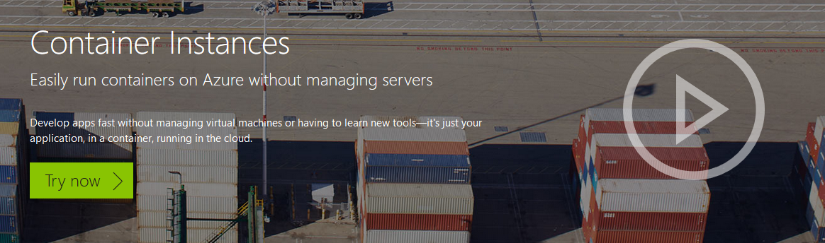
Azure Container Instances
https://azure.microsoft.com/en-us/services/container-instances/

Slide 29
Azure Container Instances
Running containers without servers
No need to manage VMs
Quick deployment
Deployed via the CLI, powershell, or Azure Portal
Billed by the second

Slide 30
ACI - Options
Linux & Windows containers
Containers exposed directly to the internet
IP Address and FQDN
Hypervisor level isolation
Persistent storage
Azure files shares

Slide 31
ACI – Container Groups
Similar in concept to K8s pods
Multiple containers running on the same host
Share IP address, containers exposed on ports
Supports mounting external volumes

Slide 32
ACI & Orchestrators
ACI - Stripped down orchestrator
Complementary to existing orchestrators
Quick and easy to scale out applications

Slide 33
ACI – Get ACR Credentials
# enable admin
az acr update -n TestContainerRegistry01 --admin-enabled true
# get credentials
az acr credential show -n TestContainerRegistry01

Slide 34
ACI – Create Keyvault
az keyvault create --resource-group containers1 --name aptestkeyvault01
az keyvault secret set `
--vault-name aptestkeyvault01 `
--name testcontainerregistry01-pull-pwd `
--value $(az ad sp create-for-rbac `
--name testcontainerregistry01-pull `
--scopes $(az acr show --name testcontainerregistry01 --query id –-output tsv)`
--role reader --query password --output tsv)
az keyvault secret set `
--vault-name aptestkeyvault01 `
--name testcontainerregistry01-pull-usr `
--value $(az ad sp show --id http://testcontainerregistry01-pull `
--query appId --output tsv)

Slide 35
ACI – Create Container
az container create `
--resource-group containers1 `
--image testcontainerregistry01.azurecr.io/devsqlimage:latest `
--registry-username $(az keyvault secret show `
--vault-name aptestkeyvault01 `
--name testcontainerregistry01-pull-usr `
--query value --output tsv) `
--registry-password $(az keyvault secret show `
--vault-name aptestkeyvault01 `
--name testcontainerregistry01-pull-pwd `
--query value --output tsv) `
--name testcontainer1 `
--cpu 2 --memory 4 `
--environment-variables ACCEPT_EULA=Y SA_PASSWORD=Testing1122 `
--ip-address public `
--ports 1433

Slide 36
ACI – Get Container Status
az container show `
--name testcontainer1
--resource-group containers1

Slide 37
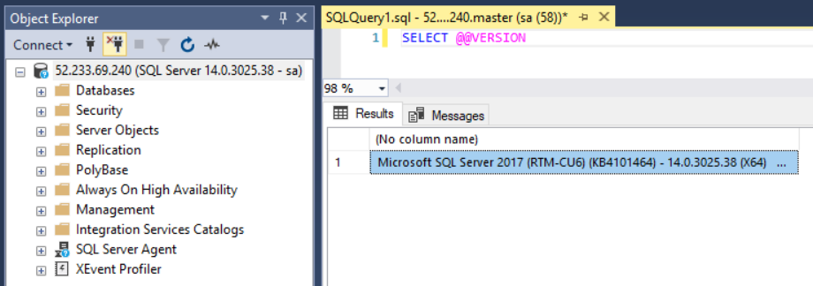
ACI – Connect to SQL Server

Slide 38
Demo

Slide 39
Azure Container Services

Slide 40
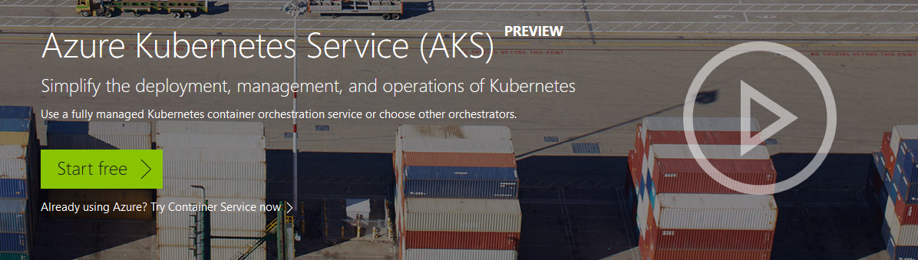
Azure Container Services
https://azure.microsoft.com/en-us/services/container-service/

Slide 41
Azure Container Services
Two flavours
Azure Container Services (ACS)
Azure Container Services (AKS)
ACS provides container hosting using DC/OS, Swarm, or K8s
AKS is specifically built to implement Kubernetes

Slide 42
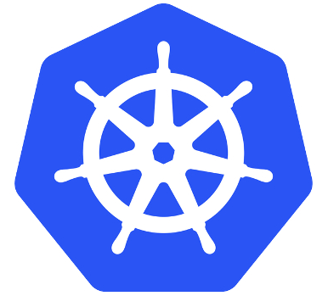
Kubernetes
Open Source system for managing containers
Deployed as a cluster containing a master and multiple nodes
Pods hold containers running on the nodes
Services define/allow access to sets of pods
Deployments created and managed via Kubectl

Slide 43
Azure Container Services (AKS)
Simplifies deployment of Kubernetes clusters in Azure
Cluster can be spun up with one line of code
Applications deployed to cluster via yaml files
Managed by Azure-CLI/powershell and kubectl

Slide 44
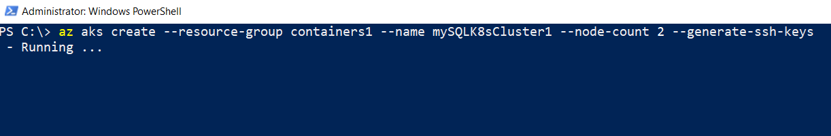
AKS – Create Cluster
az aks create `
--resource-group containers1 `
--name mySQLK8sCluster1 `
--node-count 2 `
--generate-ssh-keys

Slide 45
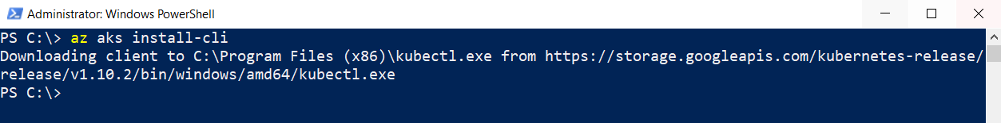
AKS – Install kubectl
az aks install-cli

Slide 46
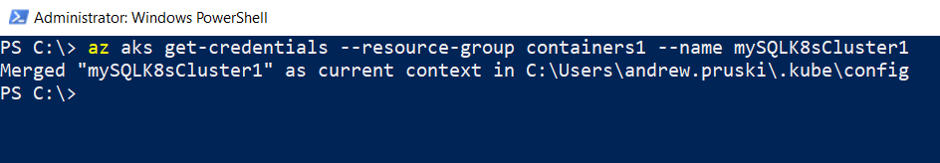
AKS – Get Cluster Credentials
az aks get-credentials `
--resource-group containers1 `
--name mySQLK8sCluster1

Slide 47
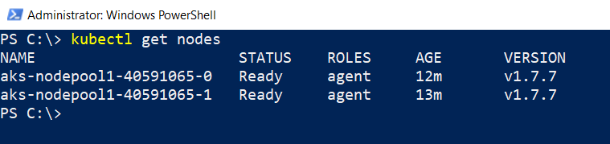
AKS – View Cluster Nodes
kubectl get nodes

Slide 48
AKS – Get Cluster & ACR Details
Get AKS Service Principal ID
az aks show `
--resource-group containers1 `
--name mySQLK8sCluster1 `
--query "servicePrincipalProfile.clientId" --output tsv
Get ACR Resource ID
az acr show `
--name TestContainerRegistry02 `
--resource-group containers1 `
--query "id" `
--output tsv

Slide 49
AKS – Create Role to Deploy
Create role to grant access
az role assignment create `
--assignee <<CLIENTID>> `
--role Reader `
--scope <<ACRID>>

Slide 50
AKS – yaml file
apiVersion: apps/v1beta1
kind: Deployment
metadata:
name: sqlserver
labels:
app: sqlserver
spec:
replicas: 1
template:
metadata:
labels:
name: sqlserver

Slide 51
AKS – yaml file
spec:
containers:
- name: sqlserver1
image: testcontainerregistry01.azurecr.io/devsqlimage:latest
ports:
- containerPort: 1433
env:
- name: SA_PASSWORD
value: "Testing1122"
- name: ACCEPT_EULA
value: "Y"

Slide 52
AKS – yaml file
apiVersion: v1
kind: Service
metadata:
name: sqlserver-service
spec:
ports:
- name: sqlserver
port: 1433
targetPort: 1433
selector:
name: sqlserver
type: LoadBalancer

Slide 53
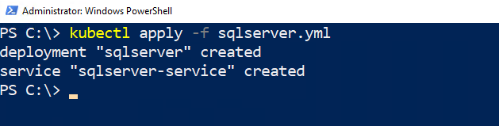
AKS – Deploy to Cluster
kubectl create -f sqlserver.yml

Slide 54
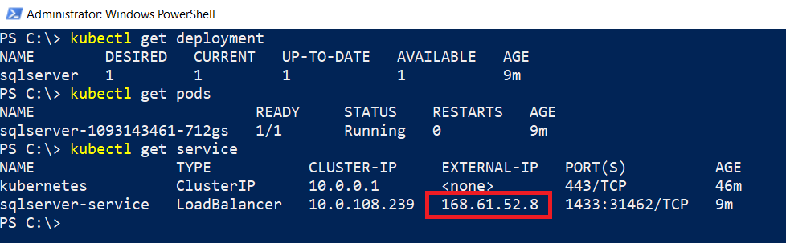
AKS – View Deployment Information
kubectl get deployments
kubectl get pods
Kubectl get service

Slide 55
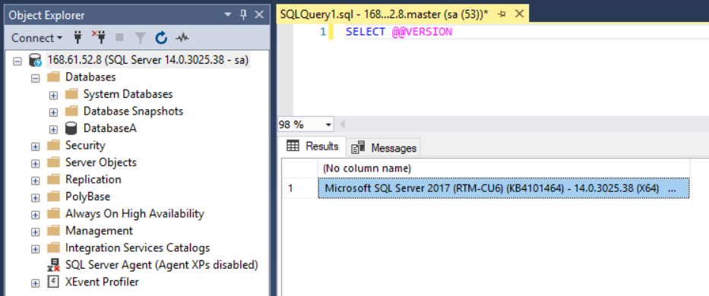
AKS – Connect to SQL Server

Slide 56
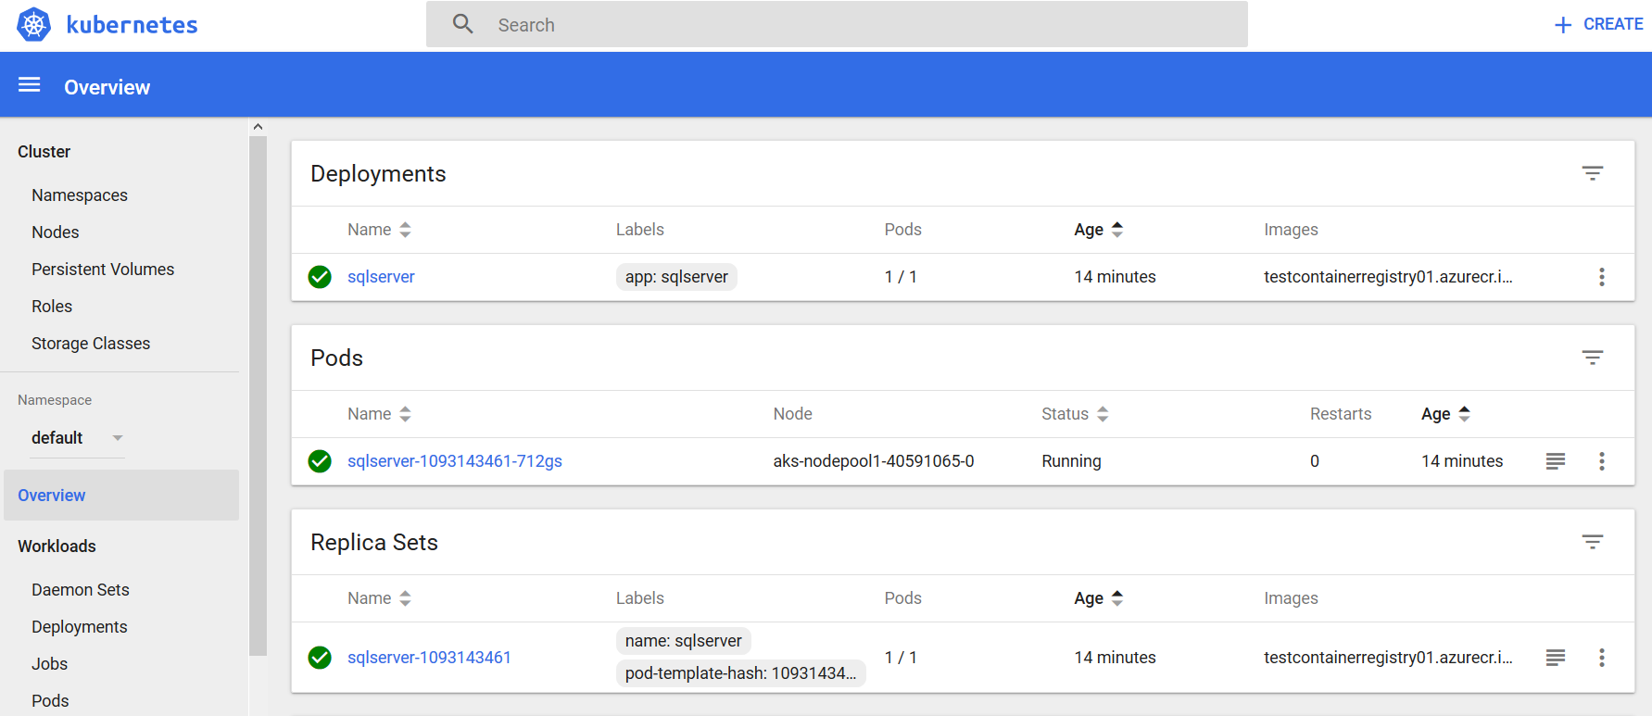
AKS – Connect to K8s Dashboard
az aks browse --resource-group containers1 --name mySQLK8sCluster1

Slide 57
Demo

Slide 58
Other options

Slide 59
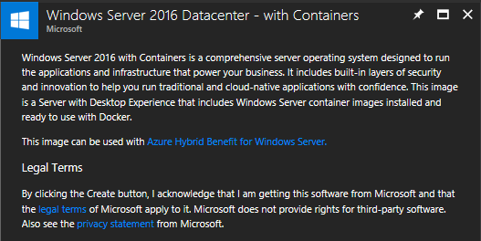
VM Templates
Windows Datacenter with Containers
Docker pre-installed
Images pre-pulled (server core & nano server)

Slide 60
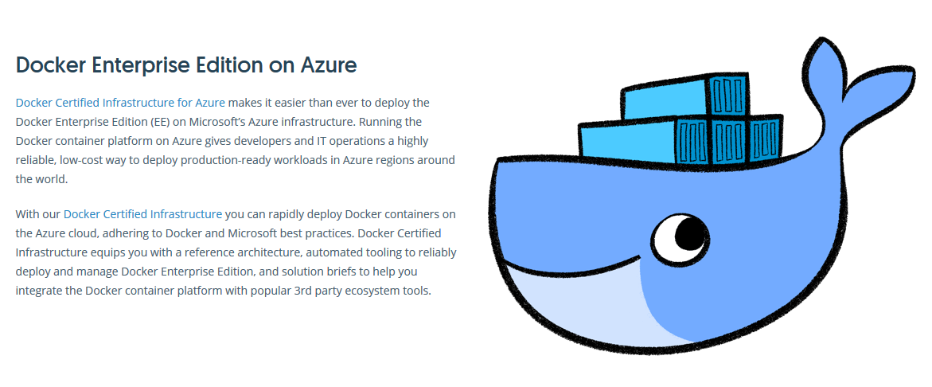

Docker EE for Azure
https://store.docker.com/editions/enterprise/docker-ee-azure

Slide 61
Resources
https://azure.microsoft.com/en-us/services/container-registry/
https://azure.microsoft.com/en-us/services/container-instances/
https://azure.microsoft.com/en-us/services/container-service/
https://dbafromthecold.com/2017/03/15/summary-of-my-container-series/
https://github.com/dbafromthecold/ContainersInTheCloud

Slide 62

Questions?

